Slide 1
Structuring Papers
General Education Literature Orientation 2014
Annmarie Steffes

Slide 2
Introductions

Slide 3
Conclusions

Slide 4
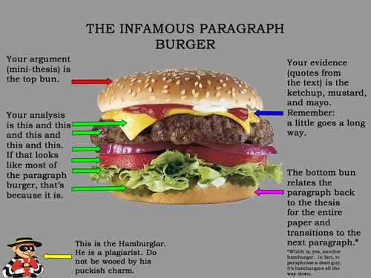
Body Paragraphs

Slide 5
Body Paragraphs (in short)
Claim/Topic Sentence
Transition/Lead-in Statement
Introduction to evidence
Evidence
Analysis of Evidence
Connection to larger thesis

Slide 6
Response Paragraphs
Response Paragraph #4 Assignment
Instructions: Gilman’s “The Yellow Wallpaper” like Poe’s “Cask of Amontillado” is a first-person narrative or monologue. Write one paragraph (5-8 sentences) where you compare the structural differences between Gilman’s and Poe’s piece and suggest how the unique aspects of Gilman’s piece contributes to the themes of her work. Your claim should state one of Gilman’s themes and explain the narrative, structural elements that help elucidate this theme.

Slide 7
Grammar Lessons
DO: appositives, active verbs
DON’T: wordiness, passive sentence structure, comma splices

Slide 8
Example: Wordiness
As a team, eliminate as many words as possible without harming the meaning of the sentence. You are not allowed to add any words – only eliminate them.
As soon as your group has a guess, write it the revised sentence up on the board with the number of words in the sentence.
First team to put a grammatically correct and sentence that does not harm the intended meaning of its original with the fewest words wins a point.

Slide 9
Example: Wordiness
Imagine a mental picture of someone engaged in the intellectual activity of trying to learn what the rules are for how to play the game of chess. (27 words)

