Slide 1
Ms. Marvel
Zachary King - March 30, 2015

Slide 2
Notes on the future
For Wednesday:
Finish Ms. Marvel
Read two short articles on ICON (Noelene Clark & Laura Hudson)
Watch Sana Amanat’s TED Talk “Myths, Misfits, & Masks” (15 minutes)
Thursday: Captain America: The Winter Soldier screening, 7:30 pm @ 205 EPB (also on digital course reserve)
Next week: Winter Soldier and Icon: A Hero’s Journey

Slide 3
Pop Quiz!

Slide 4
Pop Quiz!
Which superhero does Gloria Steinem credit with rescuing heroism from being a male prerogative?
Wonder Woman
When Ms. Marvel opens, what is Kamala doing?
Praying
Smelling bacon
Sleeping
Writing fanfiction
TRUE or FALSE: Kamala is the most devout Muslim in her family.
Which of these heroes does NOT appear to Kamala in her mist-induced vision?
Captain America
Captain Marvel
Iron Man
Spider-Man
In the context of Ms. Marvel, what is the significance of the word “Embiggen”?
Kamala changes shape upon saying it.

Slide 5
Pop Quiz!
Which superhero does Gloria Steinem credit with rescuing heroism from being a male prerogative?
Wonder Woman
When Ms. Marvel opens, what is Kamala doing?
Praying
Smelling bacon
Sleeping
Writing fanfiction
TRUE or FALSE: Kamala is the most devout Muslim in her family.
Which of these heroes does NOT appear to Kamala in her mist-induced vision?
Captain America
Captain Marvel
Iron Man
Spider-Man
In the context of Ms. Marvel, what is the significance of the word “Embiggen”?
Kamala changes shape upon saying it.

Slide 6
Pop Quiz!
Which superhero does Gloria Steinem credit with rescuing heroism from being a male prerogative?
Wonder Woman
When Ms. Marvel opens, what is Kamala doing?
Praying
Smelling bacon
Sleeping
Writing fanfiction
TRUE or FALSE: Kamala is the most devout Muslim in her family.
Which of these heroes does NOT appear to Kamala in her mist-induced vision?
Captain America
Captain Marvel
Iron Man
Spider-Man
In the context of Ms. Marvel, what is the significance of the word “Embiggen”?
Kamala changes shape upon saying it.

Slide 7
Pop Quiz!
Which superhero does Gloria Steinem credit with rescuing heroism from being a male prerogative?
Wonder Woman
When Ms. Marvel opens, what is Kamala doing?
Praying
Smelling bacon
Sleeping
Writing fanfiction
TRUE or FALSE: Kamala is the most devout Muslim in her family.
Which of these heroes does NOT appear to Kamala in her mist-induced vision?
Captain America
Captain Marvel
Iron Man
Spider-Man
In the context of Ms. Marvel, what is the significance of the word “Embiggen”?
Kamala changes shape upon saying it.

Slide 8
Pop Quiz!
Which superhero does Gloria Steinem credit with rescuing heroism from being a male prerogative?
Wonder Woman
When Ms. Marvel opens, what is Kamala doing?
Praying
Smelling bacon
Sleeping
Writing fanfiction
TRUE or FALSE: Kamala is the most devout Muslim in her family.
Which of these heroes does NOT appear to Kamala in her mist-induced vision?
Captain America
Captain Marvel
Iron Man
Spider-Man
In the context of Ms. Marvel, what is the significance of the word “Embiggen”?
Kamala changes shape upon saying it.

Slide 9
Pop Quiz!
Which superhero does Gloria Steinem credit with rescuing heroism from being a male prerogative?
Wonder Woman
When Ms. Marvel opens, what is Kamala doing?
Praying
Smelling bacon
Sleeping
Writing fanfiction
TRUE or FALSE: Kamala is the most devout Muslim in her family.
Which of these heroes does NOT appear to Kamala in her mist-induced vision?
Captain America
Captain Marvel
Iron Man
Spider-Man
In the context of Ms. Marvel, what is the significance of the word “Embiggen”?
Kamala changes shape upon saying it.

Slide 10
In the news!

Slide 11
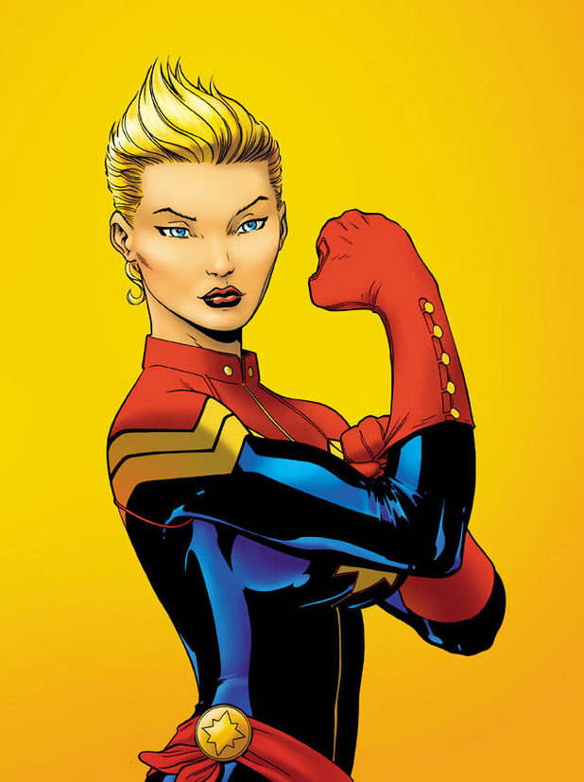
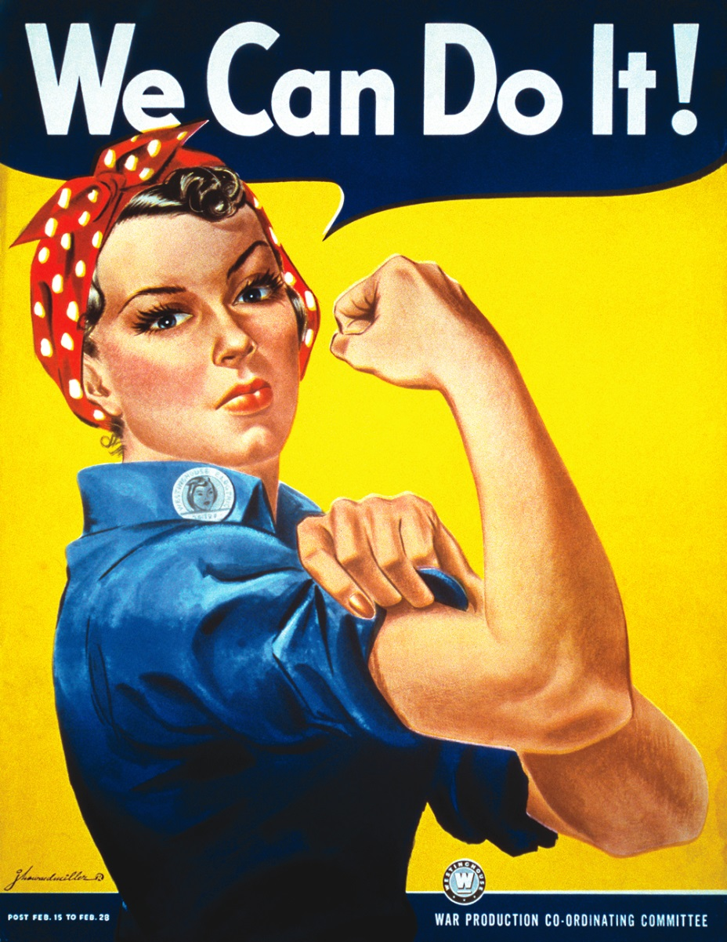
Captain Marvel

Slide 12
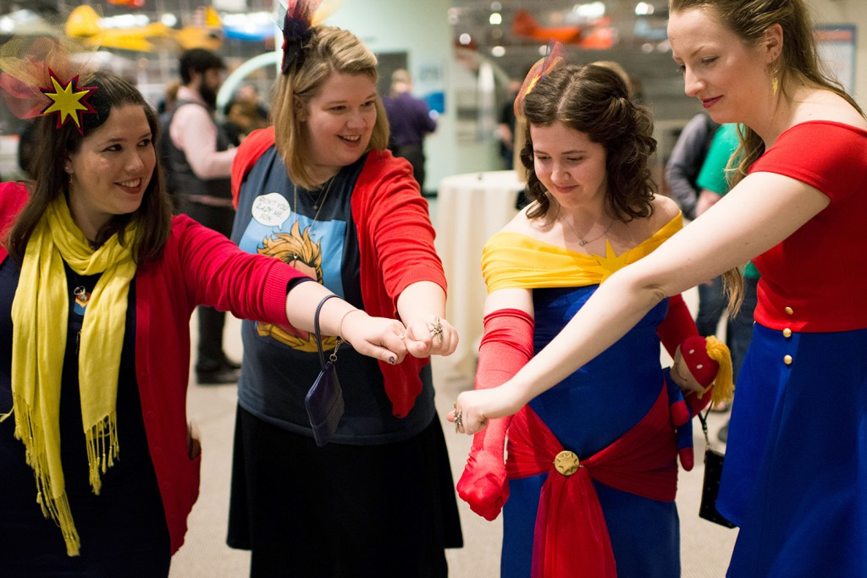
The Carol Corps

Slide 13
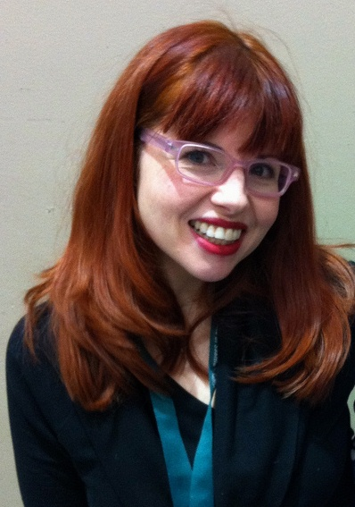
The Carol Corps
It is not a formal organization. There are no rules. People write and ask me all the time, ‘How do I join the Carol Corps?’ You join Carol Corps by saying you are Carol Corps. There is no test. You don’t have to buy anything. You don’t need to sign up anywhere. If you decide you are a part of this community, bam, you are. The other part of that is that if you decide you are a part of this community, you will be embraced and welcome.

Slide 14
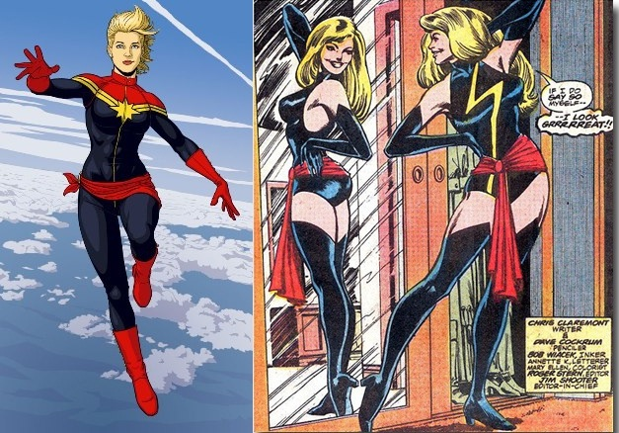
Kamala and the Carol Corps

Slide 15
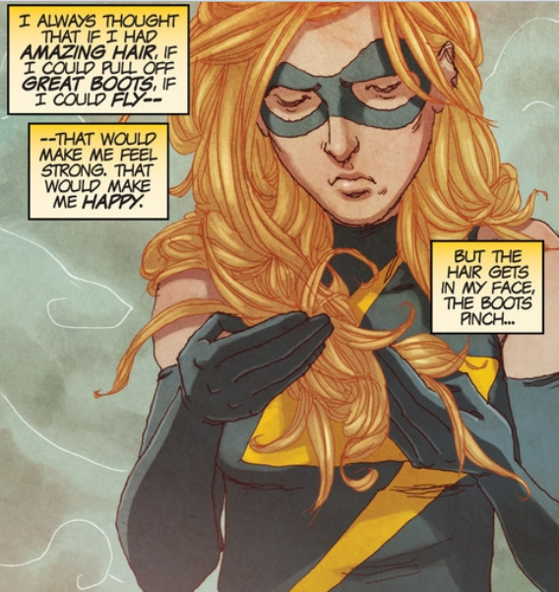
Kamala and the Carol Corps

Slide 16
Costuming/Cosplay as Agency

Slide 17
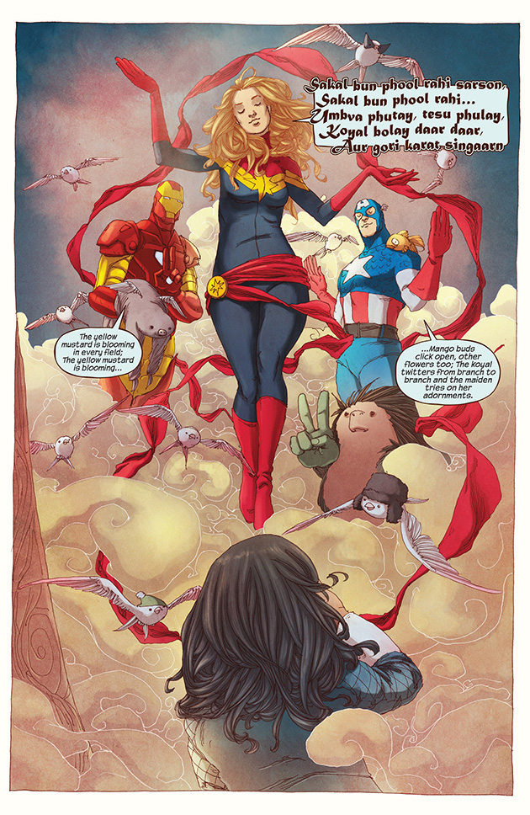
Kamala’s Religious Experience
https://youtu.be/FBAy9kJrMxc
https://youtu.be/UGUVKCm_Jx4

Slide 18
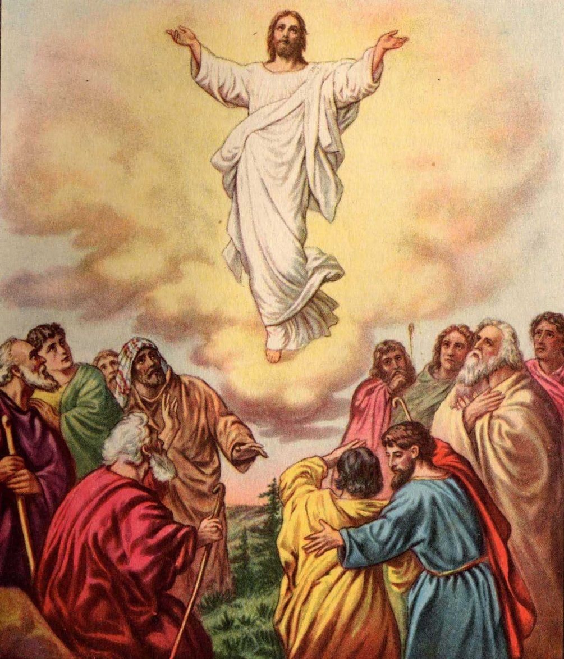
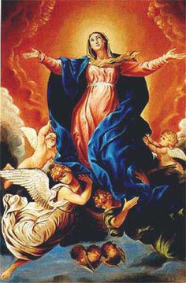
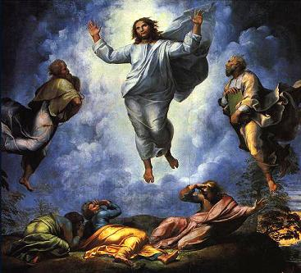
Kamala’s Religious Experience

