Slide 1
Intro to Reading Drama and Susan Glaspell’s Trifles
See also pages 1223-7 of A Portable Anthology and Elinor Fuchs, “Visit to a Small Planet”

Slide 2
Elements of Drama
In common with fiction
Setting, Plot, Tone, Characters
Specific to plays
Performance
Reading is only a part of the experience

Slide 3
Comparing Plays with Short Stories
No narrator– dialogue/stage directions, directors/actors
Characters thoughts revealed through dialogue, costume, expression, gesture
Trace symbols/themes through set/stage directions emphasis in performance
Time revealed through scenes, dialogue, set cues
Narrator present to focalize POV
Narrative descriptions can indicate thoughts/emotions of characters
Descriptions also help to indicate important symbols/themes
Time of reading differs from time of action occurring

Slide 4
Susan Glaspell (1876-1948)
Grew up on a hay farm near Davenport, IA
Became a journalist at 18, attended Drake University, member of debate
Resigned journalism at 24 in order to write, eventually moving to New York and getting involved with acting/play productions
Stories in top magazines, also 9 novels, best-sellers, and a Pulitzer Prize for drama
Lost popularity after WWI, not read much until 1970s feminist revision of the literary canon

Slide 5
Early Feminist Drama
What does it mean to be a feminist/do a feminist reading?
First-wave feminism: Political equality
Progressive Era (1890s to 1920s): “New Woman” in contrast to Victorian woman
Until 19th Amendment (1919) giving suffrage to women
Also included property, marriage, reproductive rights
Reading first-wave texts now:
Keep in mind changing definitions of gender roles
Second/third-wave feminism more about social/cultural equality and politics of representation

Slide 6
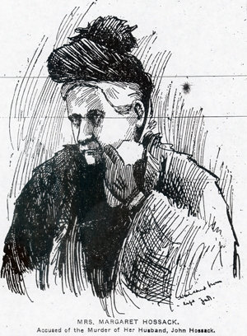
More context: Margaret Hossack case in Des Moines Daily News (December 1900)
INDIANOLA, Dec. 4.--(Special)--Persons who went to the home of John Hossack Monday and saw the murdered man in his bed, and heard portions of the testimony before the coroner's jury, are all at sea as to who killed Hossack or for what reason…The murderer came through a porch and front room to the bed room where Mr. and Mrs. Hossack slept. He evidently reached across the bed with an ax and struck two blows. One crushed in the skull and the other made a deep cut, yet Hossack lived from Saturday night until 10 a.m. Sunday, though he did not regain consciousness, and no one has yet been found who can give a clue to the murder. The ax was found under a shed about fifty feet from the house. Mrs. Hossack swore before the jury that she was awakened about midnight by the slamming of a door, saw a flash of light and then all was dark…Then she discovered him on the bed, with blood all over the clothing. She said she did not hear the blows nor see any one. . .It is rumored that trouble had arisen in the Hossack household and that possibly some relative committed the murder.

Slide 7
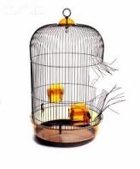
The Bird Cage
Cages. Consider a birdcage. If you look very closely at just one wire in the cage, you cannot see the other wires. If your conception of what is before you is determined by this myopic focus, you could look at that one wire, up and down the length of it, and be unable to see why a bird would not just fly around the wire any time it wanted to go somewhere…There is no physical property of any one wire, nothing that the closest scrutiny could discover, that will reveal how a bird could be inhibited or harmed by it except in the most accidental way. It is only when you step back, stop looking at the wires one by one, microscopically, and take a macroscopic view of the whole cage, that you can see why the bird does not go anywhere; and then you will see it in a moment. It will require no great subtlety of mental powers. It is perfectly obvious that the bird is surrounded by a network of systematically related barriers, no one of which would be the least hindrance to its flight, but which, by their relations to each other, are as confining as the solid walls of a dungeon.
Marilyn Frye, "Oppression", in Politics Of Reality – Essays In Feminist Theory (1983)

