Slide 1
Graphic Novels
What’s the difference between comic books and graphic novels?
Is one “higher” literature?
Should either be taught in a literature course?

Slide 2
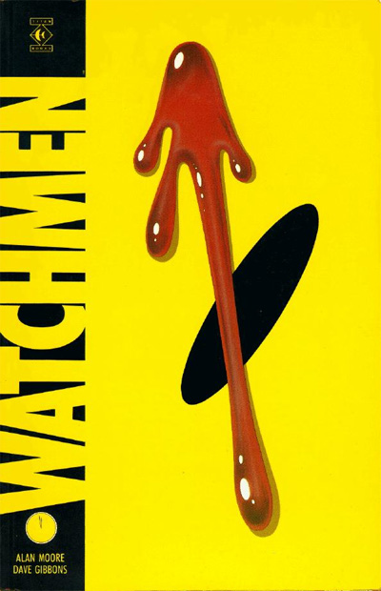
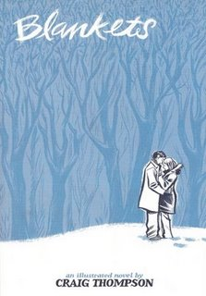
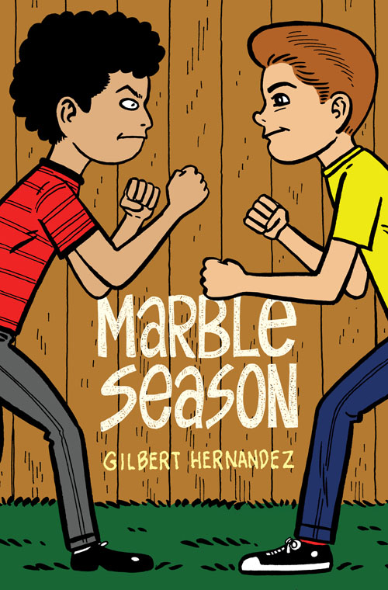
Comics
The Graphic Novel as a Form(at) of Legitimation

Slide 3
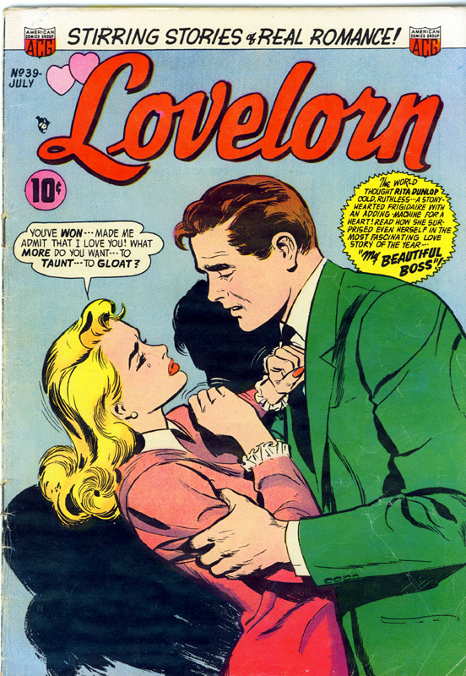
The Implicit Heteronormativity of Comics

Slide 4
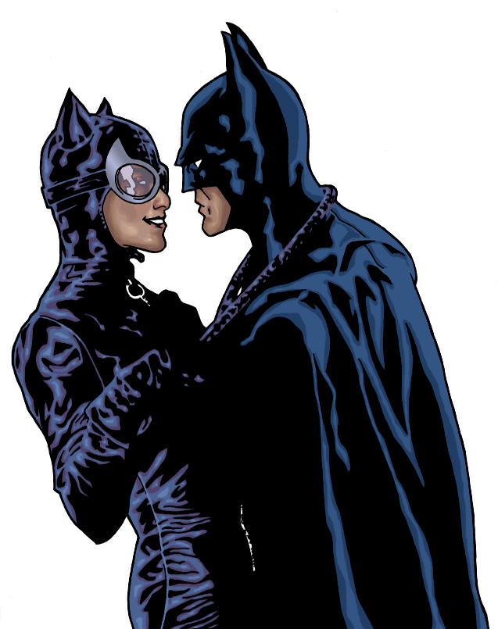
The Implicit Heteronormativity of Comics

Slide 5
The Rise of Gay and Lesbian Comics (late 70s and 80s)

Slide 6
Contemporary Queer Comics

Slide 7
Comics as an Art of Creative Tensions
Word and Image
Reading and Looking
Writing and Drawing
Silence and Sound (Simulated)
Stasis and Motion (Simulated)
Panel (Part) and Sequence (Whole)
Hand-Made Production and Mass Reproduction

Slide 8
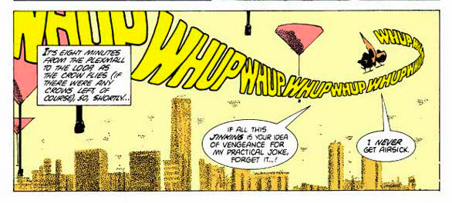
In Comics, the Verbal is Visual

Slide 9
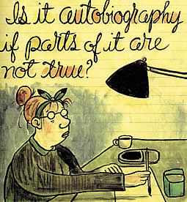
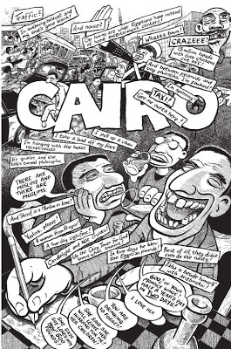
In Comics, Writing is Drawing

Slide 10
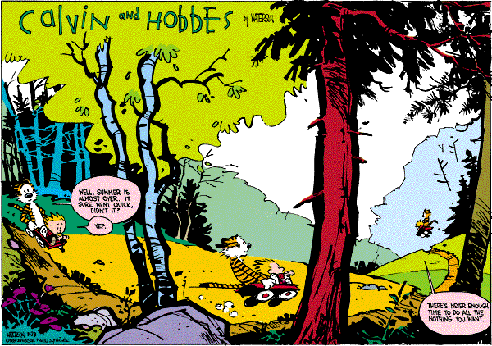
Comics as Time Spatialized

Slide 11
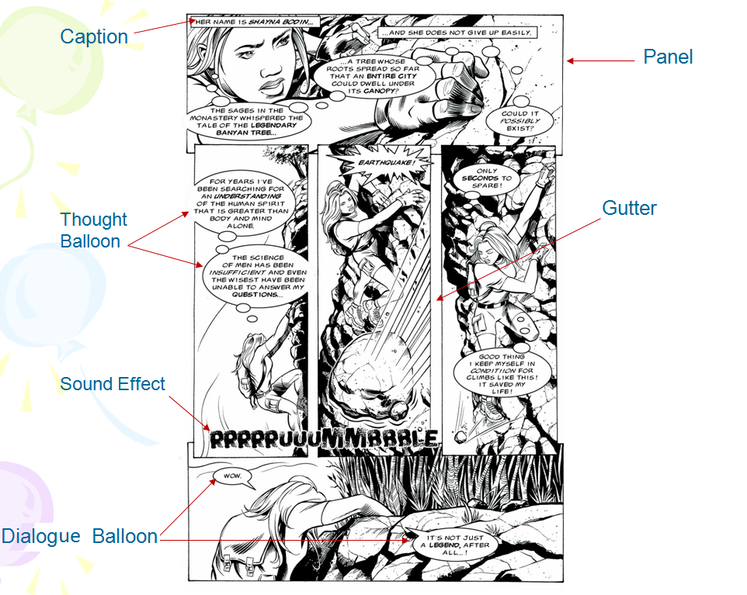

Slide 12
Panel-distinct segment of the comic containing a combo of text and image
Frame: The lines and borders that contain the panels-hold in, stuck-breaking through-disruption, surprise
Gutter: The space between framed panels.
Bleed: An image that extends to and/or beyond the edge of the page or gutter.
Foreground: The panel closest to the viewer.

Slide 13
More Vocabulary
Graphic Weight
The way some images draw the eye more than others through elements like high contrast, different shading, pattern, etc.
Figures
Faces
“open blank”—face that lacks detail, so the audience can give it meaning
Hands
Reveal emotions by their placement, eg: hands over mouth denote shame
Feet
Turned in feet denote embarrassment
Can depict motion

Slide 14
Color
High contrast
High energy
intensity
Low contrast
Low energy
Notes:
Blue green=low contrast=calm scene
Orange blue=high contrast=high energy

Slide 15
Color
High Contrast
Low Contrast

Slide 16
Line direction
Vertical
Brings energy to picture
Horizontal
Sleep, laying down, tranquil
Diagonal
Energy and excitement
Jagged
danger
Notes:
Vert-brings energy into the picture
Horizontal lines-sleep, laying down, tranquil
Diagonals-energy and excitement
Jagged-danger

Slide 17
Horizontal

Slide 18
Diagonal

Slide 19
Jagged

Slide 20
Composition
Size—whatever is bigger is more important
Bigger
Smaller
Equal
Height
Higher
Lower
Notes:
Bigger size-more important
Equal size=equality
Higher=more power
Lower=less important, weaker

Slide 21
Composition

Slide 22
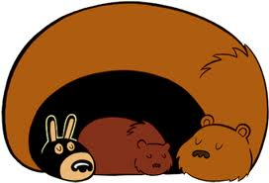
Shape
Circles
comfort
Squares
Danger, anger
Notes:
Circles-comfort enclosure
Squares/rectangles-danger, anger

