Slide 1
Crafting Clear and Polished Sentences
Techniques for improving sentence-level writing

Slide 2
Eliminate Intensifiers
Suggestion #1

Slide 3
Intensifiers
Intensifiers are words that add emphasis.
Examples:
Very
Really
Quite
Totally
Completely
Definitely
Just
So

Slide 4
Why eliminate intensifiers?
These words carry over from speech habits. When speaking, people use them with vocal stress.
In writing, stress comes from using powerful and meaningful words, not vacant intensifiers.

Slide 5
What words are intensifiers?
The really terrible storm ripped across the bay and totally destroyed business buildings and homes when it hit shore. The result was very disastrous: so much wreckage, so many helpless people, so many lost dreams. To see it was really disturbing.

Slide 6
Compare these two versions.
With Intensifiers
Without Intensifiers
The REALLY terrible storm ripped across the bay and TOTALLY destroyed business buildings and homes when it hit shore. The result was VERY disastrous: SO MUCH wreckage, SO MANY helpless people, SO MANY lost dreams. To see it was REALLY disturbing.
The terrible storm ripped across the bay and destroyed business buildings and homes when it hit shore. The result was disastrous: wreckage, helpless people, lost dreams. To see it was disturbing.

Slide 7
How will eliminating them improve your writing?
Notice that the version with intensifiers simply seemed overstated, and the version without intensifiers was just as powerful.
Once intensifiers are removed, however, you can see that the section needs to be developed further.
Add vivid details instead of intensifiers.

Slide 8
Example with More Development
This is a revision of the following line:
“The result was disastrous: wreckage, helpless people, lost dreams.”
“The result was disastrous: wreckage floating in the flooded streets, helpless people clinging to each other on high ground and rooftops, and lost dreams that seemed to be carried away with the biting wind.”

Slide 9
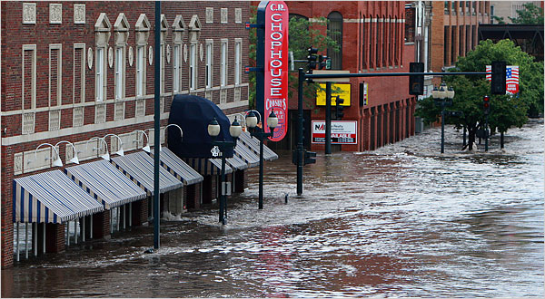
The second version is much more specific and allows the reader to create a vivid picture in his or her mind.

