Slide 1
Brief Wondrous Life of Oscar Wao
Junot Díaz

Slide 2
The book: some basics
Published 2008
Pulitzer Prize
Settings & Time Period:
U.S. (New Jersey, New York)
D.R.
Late twentieth century
Mid twentieth century (jumps back and forth)
Read intro handouts & links for more details

Slide 3
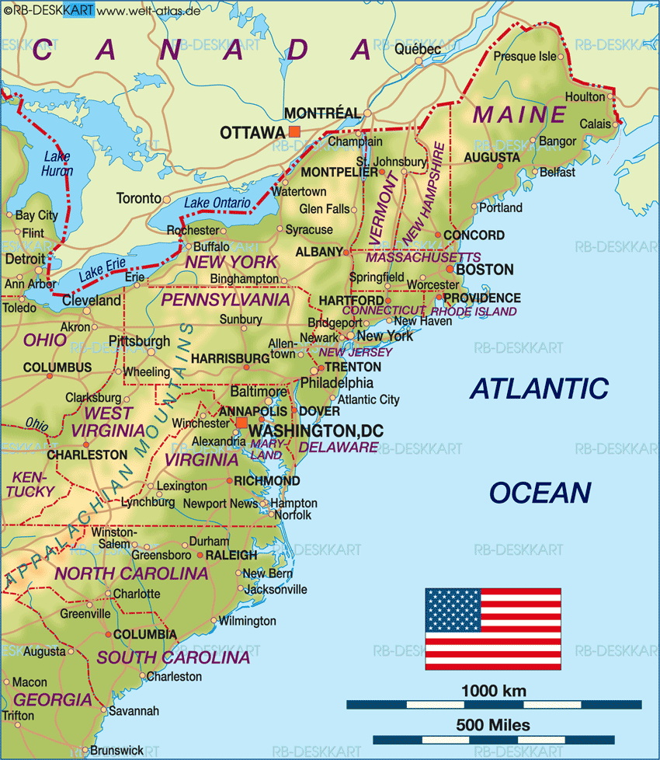
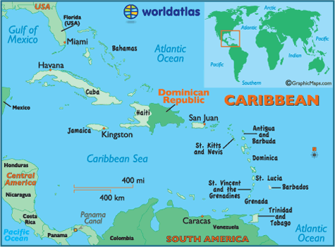

Slide 4
As you read (style & key terms)
Language
(English, Spanish, Spanglish, Dominican Slang)
Experience of being immigrant
Reader – disoriented
LIMINAL space – “in betweeness”
Reader & characters both feel this
Narrative Style
Disjointed, jumps around, several perspectives, settings
DIASPORA – dispersal
Dominican Diaspora key to the novel (1960s on) – many Dominicans migrating to U.S.
ALLUSIONS – direct reference to another work of literature, art, culture, etc.
Diversity, plethora
KEY: All of these techniques are intentional!

Slide 5
Context
Dominican History – colonial subjects, independent country, tumultuous relationship with U.S. (sometimes allies, sometimes occupiers)
Trujillo – “El Jefe” – brutal dictator 1930-1961
Huge impact on DR people, migration, etc
Díaz – Dominican American – migrated to U.S. at age of six

Slide 6
Video Clips
http://thecolbertreport.cc.com/videos/ir7gne/junot-diaz
http://thecolbertreport.cc.com/videos/bwz16t/junot-diaz
/watch?v=TEBsTTM7tBc&app=desktop
https://www.youtube.com/watch?v=lD44jmeAHJY

